Slide 1

Cloud Service Models

Slide 2
Intended learning outcomes
After completing this topic, you will be able to:
Differentiate between different types of cloud service models
Be able to choose the appropriate cloud service model for different needs

Slide 3
Cloud service models
Introduction and evolution of cloud service models
Infrastructure as a Service (IAAS)
Platform as a Service (PAAS)
Software as a Service (SAAS)
More Services (XAAS)
Comparison between different models

Slide 4
Recall our cloud computing definition
Cloud computing is the delivery of different services through the Internet, which includes tools and applications like data storage, servers, databases, networking, and software.

Slide 5
different services available in the cloud
Access to physical servers, virtual servers, storage, networking
Access to platforms for developing, running, maintaining and managing applications
Access to application software

Slide 6
different services available in the cloud
Access to physical servers, virtual servers, storage, networking - Infrastructure
Access to platforms for developing, running, maintaining and managing applications - Platform
Access to application software – Software

Slide 7
Cloud services
Cloud services are infrastructure, platforms, or software that are hosted by third-party providers and made available to users through the internet.

Slide 8
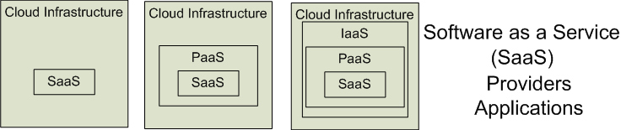

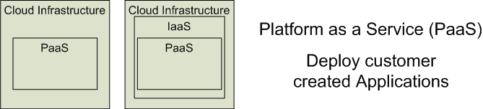

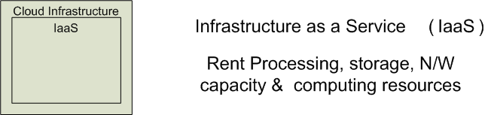


Cloud Service Models
Software as a Service (SaaS)
Platform as a Service (PaaS)
Infrastructure as a Service (IaaS)
SalesForce CRM
LotusLive
Google App Engine

Slide 9
Cloud service models
IaaS
PaaS
SaaS

Slide 10
Cloud service models
IaaS – Infrastructure
PaaS – Platform
SaaS – Software
as a Service

Slide 11
'… as a service’ (1)
refers to the way IT assets are consumed
It also describes the essential difference between cloud computing and traditional IT

Slide 12
'… as a service’ (2)
In traditional IT, an organization consumes IT assets - hardware, system software, development tools, applications - by purchasing them, installing them, managing them and maintaining them in its own on-premises data center.

Slide 13
'… as a service’ (3)
In cloud computing, the cloud service provider owns, manages and maintains the assets; the customer consumes them via an Internet connection, and pays for them on a subscription or pay-as-you-go basis.
There are three main types of as-a-Service solutions:
IaaS
PaaS
SaaS

Slide 14
'… as a service’ (4)
The main advantage of IaaS, PaaS, SaaS or any 'as a service' solution is economic
A customer can access and scale the IT capabilities it needs without the expense and overhead of purchasing and maintaining everything in its own data center.
But there are additional advantages specific to each of these solutions.

Slide 15
IaaS, PaaS, SaaS (1)
IaaS - infrastructure as a service - on-demand access to cloud-hosted physical and virtual servers, storage and networking - the backend IT infrastructure for running applications and workloads in the cloud
PaaS - platform as a service - on-demand access to a complete, ready-to-use, cloud-hosted platform for developing, running, maintaining and managing applications
SaaS - software as a service - on-demand access to ready-to-use, cloud-hosted application software

Slide 16
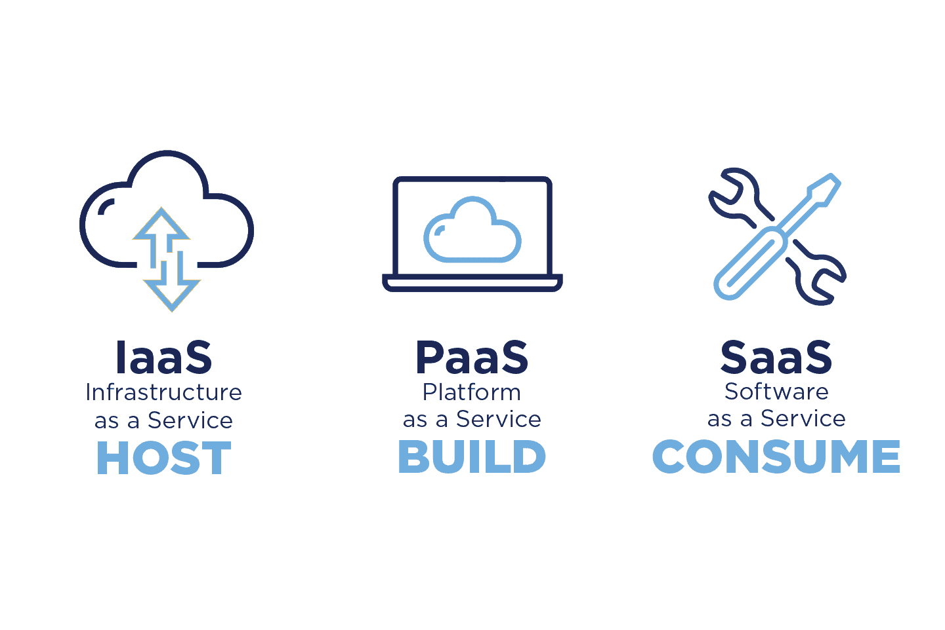

Slide 17
IaaS, PaaS, SaaS (2)
IaaS, PaaS and SaaS are not mutually exclusive. Many mid-sized businesses use more than one, and most large enterprises use all three
Each cloud service comes with its own set of advantages that can cater to various business requirements
We require a clear understanding of these cloud models to find out which one can work the best for specific needs of users
Let us understand each of the models and find out their merits

Slide 18
Evolution of cloud service models
IaaS can be thought of as the original 'as a service' offering
Every major cloud service provider - Amazon Web Services, Google Cloud, IBM Cloud, Microsoft Azure - began by offering some form of IaaS

Slide 19
Infrastructure as a Service (IAAS)

Slide 20
Infrastructure as a Service (IAAS)
The virtual delivery of computing resources in the form of hardware, networking, and storage services
Infrastructure is hosted by third-party providers and made available to users through the internet
Rather than buying and installing the required resources in their own data center, companies rent these resources as needed

Slide 21
What is infrastructure
Servers
Storage capacity
Networking resources

Slide 22
How infrastructure is provided
The cloud service provider hosts, manages and maintains the hardware and computing resources in its own data centers.
Customers can provision, configure and operate the servers and infrastructure resources via a graphical dashboard, or programmatically through application programming interfaces (APIs)
Typically IaaS customers can choose between virtual machines (VMs) hosted on
shared physical hardware
bare metal servers on dedicated (unshared) physical hardware

Slide 23
IaaS characteristics
Users are provided with virtualized hardware and storage on top of which they can build their infrastructure
Dynamic scaling
Self scaling
Alterable cost – utility pricing model
Pay as you go
Ability to provide single hardware to many users
The costs are less due to the share of infrastructure

Slide 24
User activities in IaaS
Configures the infrastructure
Setups the infrastructure
Installs, manages and monitors any required software

Slide 25
Typical level of control granted to cloud user in IaaS
Full administrative

Slide 26
Cloud provider activities in IaaS
Manages and provisions the storage
Physical processing, hosting and networking
Monitors usage by the consumer of cloud

Slide 27
Who manages what in IaaS model
A cloud service provider
manages the infrastructure for the user
The actual servers, network, virtualization, and data storage
has the responsibility of taking care of
Outages
Repairs
Hardware issues
The user
has access through an API or dashboard, and essentially rents the infrastructure
manages things like the operating system, apps, and middleware

Slide 28
Vendors of IaaS
Amazon
Gogrid,
RACKSPACE
IBM BlueHouse
Linode
VMWare

Slide 29
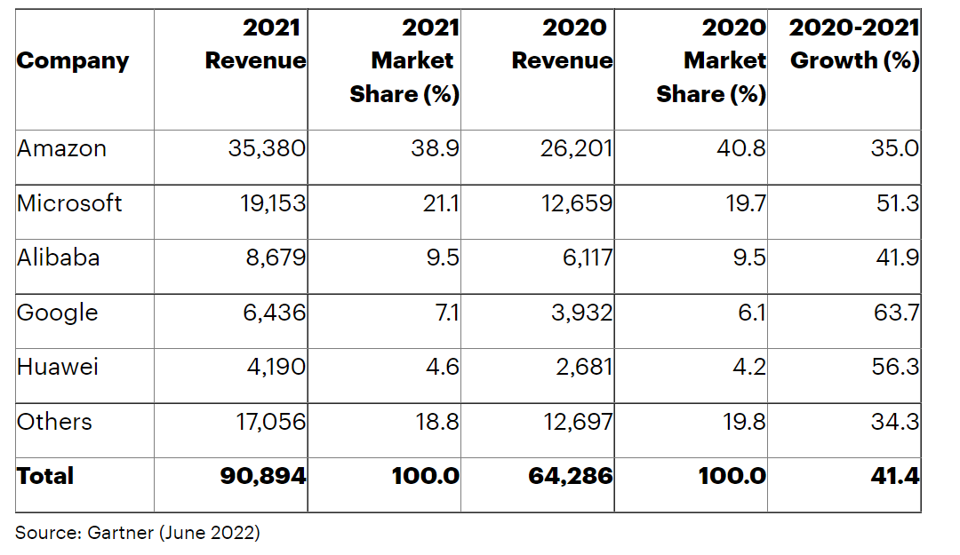
Worldwide IaaS Public Cloud Services Market Share, 2020-2021 (Millions of U.S. Dollars)

Slide 30
IaaS Example - Amazon Web Services
A public cloud that offers subscribers
Access to virtual servers for product deployment
Cloud storage
Tools for development, testing, and analytics
The application provides a ready-to-use environment to develop and test the product and offers the full cloud infrastructure for its deployment and maintenance

Slide 31
AWS Free Usage Tier
Free Amazon EC2 (elastic compute) Micro Instance for a year
Includes free usage tier for:
Amazon S3
Amazon Elastic Block Store
Amazon Elastic Load Balancing
AWS data transfer
Free usage of AWS Management Console to build and manage applications on AWS
AWS’s free usage tier can be used for anything you want to run in the cloud:
Launch new applications
Test existing applications in the cloud
Gain hands-on experience with AWS

Slide 32
AWS Free Usage Tier
Free Amazon EC2 (elastic compute) Micro Instance for a year
Includes free usage tier for:
Amazon S3
Amazon Elastic Block Store
Amazon Elastic Load Balancing
AWS data transfer
Free usage of AWS Management Console to build and manage applications on AWS
AWS’s free usage tier can be used for anything you want to run in the cloud:
Launch new applications
Test existing applications in the cloud
Gain hands-on experience with AWS

Slide 33
Amazon Elastic Compute (EC2) Instances
A virtual server is referred to as an Amazon EC2 instance
Amazon Elastic Compute Cloud (Amazon EC2) is a component of AWS and central to many cloud-based applications
A micro Amazon EC2 instance can be launched in the free usage tier
Micro instances provide a small amount of consistent CPU resources and allow o burst CPU capacity when additional cycles are available (613 MB of memory, up to 2 ECUs (for short periodic bursts), EBS storage only, 32-bit or 64-bit platform)
A micro instance is well suited for lower throughput applications and web sites that consume significant compute cycles only occasionally
To request an Amazon EC2 instance, you use the Request Instances wizard or the Quick Launch wizard to specify an Amazon Machine Image (AMI)
An AMI contains all the information that AWS needs to create the instance
Amazon EC2 instances can also be launched automatically when you deploy a web application using AWS Elastic Beanstalk

Slide 34
Amazon Simple Storage Service (S3)
Amazon S3 is storage for the Internet
Amazon S3 provides a simple web services interface that can be used to store and retrieve any amount of data, at any time, from anywhere on the web
It gives any developer access to the same highly scalable, reliable, secure, fast, inexpensive infrastructure that Amazon uses to run its own global network of web sites
S3 allows to write, read, and delete objects containing from 1 byte to 5 terabytes of data each. The number of objects you can store is unlimited
Each object is stored in a region-specific bucket and retrieved via a unique, developer-assigned key
Data stored in Amazon S3 is secure by default
Only bucket and object owners have access to the Amazon S3 resources they create
Amazon S3 supports multiple access control mechanisms, as well as encryption for both secure transit and secure storage on disk
Typical use cases
Content storage and distribution
Storage for data analysis
Backup, archiving and disaster recovery

Slide 35
IaaS Example - IBM Infrastructure
IBM uses its in-house services to store the data of infrastructure users, enabling remote data access via Cloud computing
IBM servers support AI, blockchain, and the Internet of Things
The infrastructure also provides Cloud storage and virtual development environments, enabled on the subscription basis

Slide 36
IaaS Example - Google Cloud Infrastructure
A large network of international servers that provides users access to remote Cloud data centers.
Companies can store their information in Asia, Europe, Latin America, which minimizes the risk of a security breach

Slide 37
IaaS advantages
Last time, we talked about advantages of the cloud computing technology in general
Can you think of at least one advantage of IaaS?

Slide 38

Open Question
Points: 10
Can you think of at least one advantage of IaaS?
Open Question is only supported on Version 2.0 or newer.
Answer

Slide 39
IaaS advantages – cost minimization
The deployment of an IaaS cloud model helps eliminate the requirement for the deployment of on-premise hardware.
Reducing the cost of human resources
Reducing the cost of hardware
Reducing ROI risk and low obstacles to entry
IaaS customers pay on a per-user basis, typically by the hour, week, or month.

Slide 40
IaaS advantages - increased scalability
This is the most flexible cloud computing model
Enables users to work with the flexibility of scaling the computing resources up or down based on the incoming demands and requirements
Automated scaling
The client able to increase or decrease the infrastructure on demand

Slide 41
IaaS advantages - improved responsiveness
Customers can provision resources in a matter of minutes, test new ideas quickly and quickly roll out new ideas to more users

Slide 42
IaaS advantages - higher availability
With IaaS a company can create redundant servers easily, and even create them in other geographies to ensure availability during local power outages or physical disasters.

Slide 43
IaaS advantages - easy deployment
IaaS comes with easy deployment of the servers, processing unit, storage and networking infrastructure
Customers can set it up and start working with it immediately
There is no need to manage the underlying data center or the introduction of new releases of the development or underlying software. This is all handled by the IaaS Cloud Provider.

Slide 44
Challenges of IaaS
Challenges faced by service providers that offer IaaS services to clients and customers
subscriber expectation management
defining support systems that handle different forms of payments from customers
accommodating the need for custom analytics that measures customer profitability and usage
managing the service value chain
controlling business with multiple partners

Slide 45
IaaS use cases (1)
Disaster recovery
Instead of setting up redundant servers in multiple locations, IaaS can deploy its disaster recovery solution to the cloud provider's existing geographically-dispersed infrastructure

Slide 46
IaaS use cases (2)
E-commerce
IaaS is an excellent option for online retailers that frequently see spikes in traffic
The ability to scale up during periods of high demand and high-quality security are essential in today’s 24-7 retail industry

Slide 47
IaaS use cases (3)
Applications that work with huge volumes of data
Internet of Things (IoT)
event processing
artificial intelligence (AI)
IaaS makes it easier to set up and scale up data storage and computing resources

Slide 48
IaaS use cases (4)
Startups
Startups can't afford to sink capital into on-premises IT infrastructure
IaaS gives them access to enterprise-class data center capabilities without the up-front investment in hardware and management overhead

Slide 49
IaaS use cases (5)
Software development
With IaaS, the infrastructure for testing and development environments can be set up much more quickly than on-premises.
However, this use case is better suited to PaaS

Slide 50
Discussion
Suppose a large organization wants to deliver a customer relationship management (CRM) application to its sales team.
CRM software connects all the data from sales leads and customers. It consolidates all communications (form fills, calls, emails, text messages, and meetings), documents, quotes, purchases, and tasks associated with each lead and client.
Can they choose an IaaS model?

Slide 51
Multiple Choice(single)
Points: 1
Suppose a large organization wants to deliver a customer relationship management (CRM) application to its sales team.
(*) CRM software connects all the data from sales leads and customers. It consolidates all communications (form fills, calls, emails, text messages, and meetings), documents, quotes, purchases, and tasks associated with each lead and client.
Can they choose an IaaS model?
A
YES
B
NO
Submit

Slide 52
Answer
Yes

Slide 53
Discussion
If the company chooses an IaaS model,
what will be their own responsibility?
what will be provided by the cloud provider?

Slide 54
Open Question
Points: 10
If the company chooses an IaaS model, what will be their own responsibility and what will be provided by the cloud provider?
Open Question is only supported on Version 2.0 or newer.
Answer

Slide 55
Answer
They can build out backend IT infrastructure on the cloud using IaaS, and use it to build its own development platform and application.
The organization's IT team would have complete control over operating systems and server configurations, but also bear the burden of managing and maintaining them, along with the development platform and applications that run on them.

Slide 56
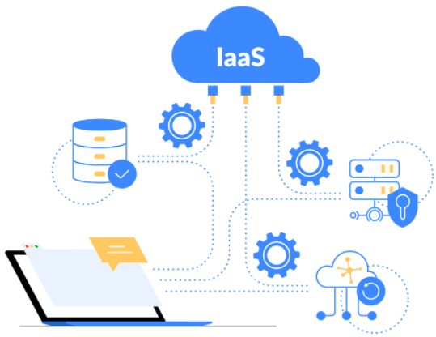

Slide 57
Cloud services
Cloud services are infrastructure, platforms, or software that are hosted by third-party providers and made available to users through the internet.

Slide 59
Platform as a Service (PAAS)

Slide 60
Platform as a Service (PAAS) - 1
Platform as a Service is software that provides access to development tools, APIs, and deployment instruments
Users receive access to virtual development environments and Cloud storage, where they can build, test, and run applications.

Slide 61
Platform as a Service (PAAS) - 2
Platform is hosted by third-party providers and made available to users through the internet
PaaS providers host the hardware and software on their infrastructure, thereby releasing customers from any obligation to install in-house hardware and software to develop or run a new application

Slide 62
Platform as a Service (PAAS) - 3
The consumer does not manage or control the underlying cloud infrastructure including network, servers, operating systems, or storage
The consumer has control over the deployed applications and possibly configuration settings for the application-hosting environment

Slide 63
What is platform
Cloud-based platform for developing, running, managing applications
hardware and software
servers for development, testing and deployment
operating system (OS) software
storage, networking, databases, middleware, runtimes, frameworks,
development tools
…

Slide 64
How is platform provided
PaaS provides a virtual runtime environment through which users can acquire space to develop and test various applications.
The cloud services provider hosts, manages and maintains all the hardware and software included in the platform as well as related services for security, operating system and software upgrades, backups and more.
Users access the PaaS through a graphical user interface (GUI), where development teams can collaborate on all their work across the entire application lifecycle including coding, integration, testing, delivery, deployment, and feedback.

Slide 65
PaaS characteristics
Users are provided with a platform for developing applications hosted in the Cloud
Services to develop, test, deploy, host and maintain applications
Users can use Web based user interface creation tools help to modify, create, deploy and test different UI scenarios
Same development application could be utilized by many users
Support for development team collaboration
Tools available to handle billing and subscription management
It consumes cloud infrastructure

Slide 66
User activities in PaaS
Tests cloud based solutions and cloud services
Develops cloud based solutions and cloud services
Manages cloud based solutions and cloud services
Deploys cloud based solutions and cloud services

Slide 67
Typical level of control granted to cloud user in PaaS
Limited administrative

Slide 68
Cloud provider activities in PaaS
Pre-configure platform
Provision underlying infrastructure, middleware and other required IT resources
Monitor usage by a consumer of the cloud

Slide 69
Who manages what in PaaS model
PaaS means the hardware and an application-software platform are provided and managed by an outside cloud service provider
The user handles the apps running on top of the platform and the data the app relies on.

